Slide 1

Cardiovascular Disease Detection
By Morgan Baccus and Jacky Wu
Notes:
Jacky

Slide 2
Introduction
What is the problem?
To predict if a patient will develop cardiovascular disease based on the features in the dataset.
Why is it important?
The patient can treat the disease preventatively as to delay the onset of symptoms or reduce the severity of the disease.
What is your basic approach?
Implement ML algorithms to predict if a patient will develop cardiovascular disease based on the value of the features in the dataset.
We will find the features that most strongly correlate to detected cardiovascular disease.
Evaluate the performance of each ML model.
Notes:
Mogan

Slide 3
Problem Definition
Explore and visualize the dataset.
Use the Sklearn library to implement several classification machine learning algorithms.
Use the models to predict if a patient will develop cardiovascular disease based on the values of the provided features.
Calculate a variety of metrics to compare the performance of all the different algorithms implemented.
Notes:
Jacky

Slide 4
Models/Algorithms/Measures
Using Sklearn library, we implemented the following models:
Decision tree
K-Nearest Neighbors with K=5
Logistic Regression
Gaussian Naïve Bayes
Support Vector Machines
We compared the above models by calculating:
F1 Score
Accuracy
Precision
Recall
Cross-Validation Score
Notes:
Morgan

Slide 5
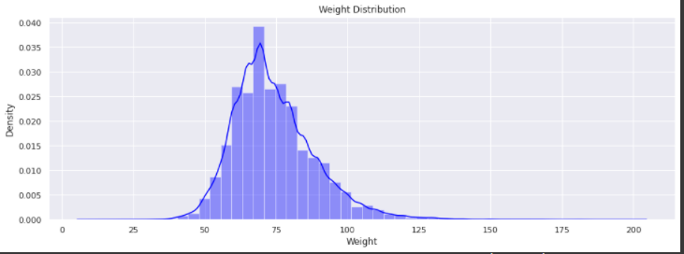
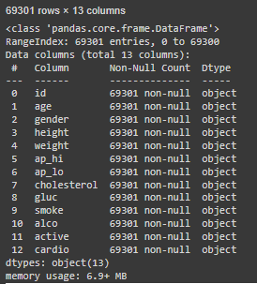
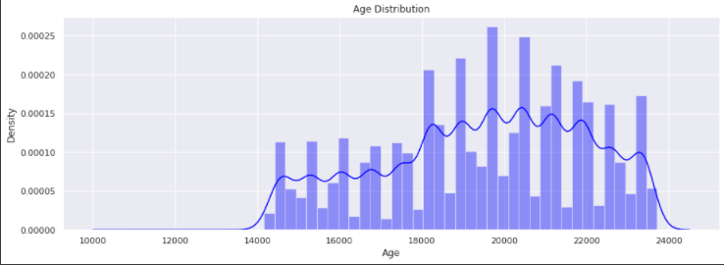
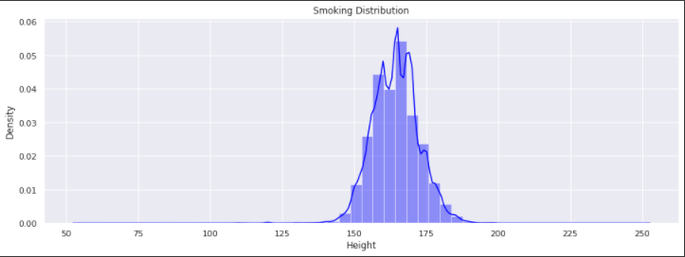
Exploratory Data Analysis
Notes:
Jacky

Slide 6

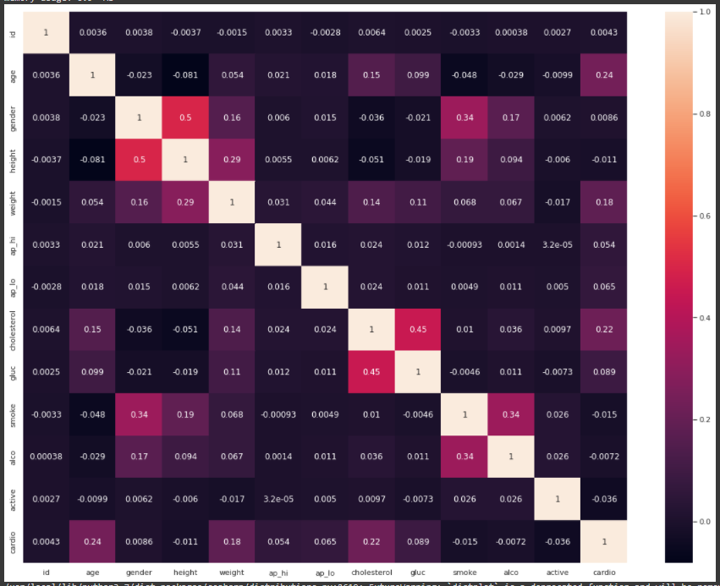
Heat map
Notes:
Morgan

Slide 7
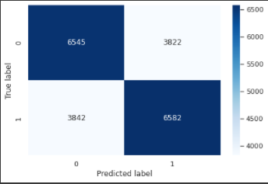
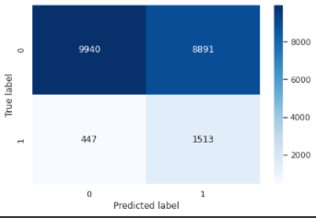
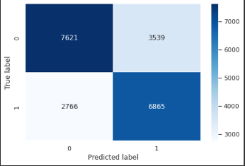
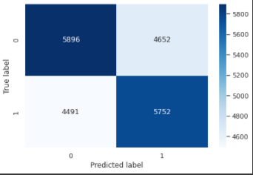
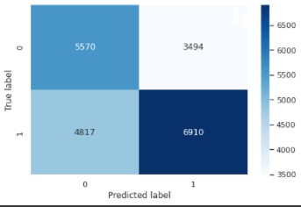
Decision Tree
Gaussian Naïve Bayes
Logistic Regression
KNN (k=5)
Support Vector Machines
Notes:
Jacky

Slide 8
Comparison between models
 | F1 | Accuracy | Precision | Recall | Cross-Val Score
Decision Tree | 0.633862935875 | 0.633591457842 | 0.632869463729 | 0.634864092937 | 0.636796536797
KNN (k=5) | 0.563267255792 | 0.560242412582 | 0.558968524839 | 0.567632617695 | 0.554359925788
Logistic Regression | 0.707383858542 | 0.696743783368 | 0.682885304659 | 0.733705593530 | 0.696310039167
Gaussian Naïve Bayes | 0.680402491615 | 0.550863354336 | 0.527853008337 | 0.956965437566 | 0.553988868275
Support Vector Machines | 0.572721196854 | 0.600259727767 | 0.614518976169 | 0.536247232117 | 0.595403009689
Notes:
Morgan

Slide 9
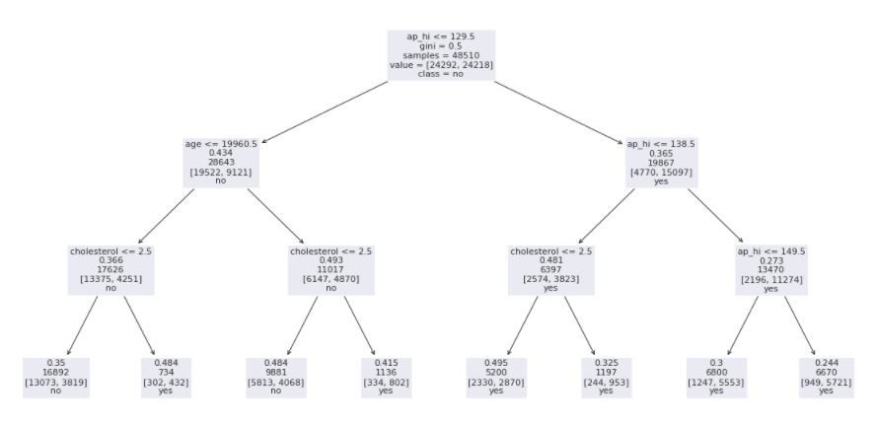
Notes:
Jacky

Slide 10
Conclusion
Logistic regression performed the best
KNN and Gaussian Naïve Bayes performed the worst
KNN might do better with a different K-value
Gaussian Naïve Bayes is meant for continuous variables, but we had a mix between continuous and discrete. A different version might be better.
Highest correlating variables with detecting cardiovascular disease are:
Age
Cholesterol
Weight
Notes:
Morgan

